Slide 1
Recognition of Human Activities Using Signals from Inertial Sensors Embedded in Smartphones
Qing Cai (qcai3@jhu.edu)
Lingjie Sang (lingjiesang@jhu.edu)
Dec 16th, 2015

Slide 2
Introduction and Data
Features: 561-dimension fea- ture vector extracted from inertial signals recorded within 2.5-second time window
Six category outcome: walking, walking upstairs, walking downstairs, sitting, standing, lying
Training data size: 7352
Testing data size: 1470
Figure 1: Human activity recognition problem and solu- tion. Adopted from (Anguita, 2013).

Slide 3
Methods
Implement with original 516 features
Support vector machine
Logistic regression
Neural network
Random forest
Gradient boosting trees
Dimensionality Reduction
Principal component analysis
Linear discriminant analysis
Feature importance analysis by random trees
Online Model

Slide 4
Some Results
Figure 2: Tuning kernel function and penalty values for SVM.

Slide 5
Some Results (cont’d)
Figure 9: Tuning the number of components in LDA, and test the LDA-generated features by SVM.

Slide 6
Some Results (cont’d)
Figure 10: Result of all methods.

Slide 7
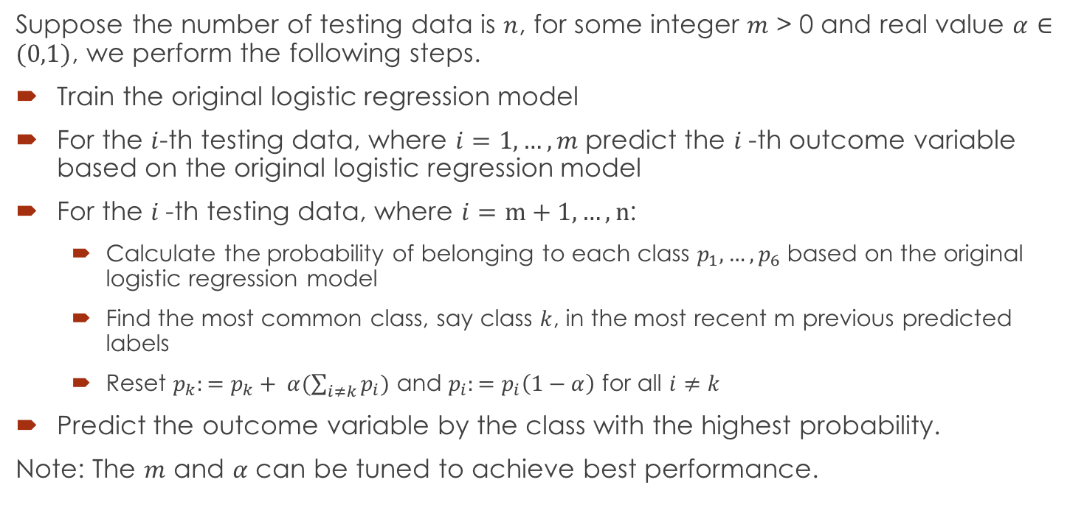
Online Model
Suppose the number of testing data is $n$, for some integer $m$ > 0 and real value $α∈(0,1)$, we perform the following steps.
Train the original logistic regression model
For the $i$-th testing data, where $i=1, …, m$ predict the $i$-th outcome variable based on the original logistic regression model
For the $i$-th testing data, where $i=m+1, …, n$:
Calculate the probability of belonging to each class $p_{1}, …, p_{6}$ based on the original logistic regression model
Find the most common class, say class $k$, in the most recent m previous predicted labels
Reset $p_{k}:=p_{k}+ α(\sum_{i≠k}{p_{i}})$ and $p_{i}:=p_{i}\left(1−α\right)$ for all $i≠k$
Predict the outcome variable by the class with the highest probability.
Note: The $m$ and $α$ can be tuned to achieve best performance.

Slide 8
Acknowledgments
We would like to thank Professor Ilya Shpitser, Tuo Zhao and Hainan Xu for their support and help with this project and throughout this sememster.

